Slide 1
Project – Smartphone Trucker Tracker
Design Overview Adam Coetzee - 29982995

Slide 2
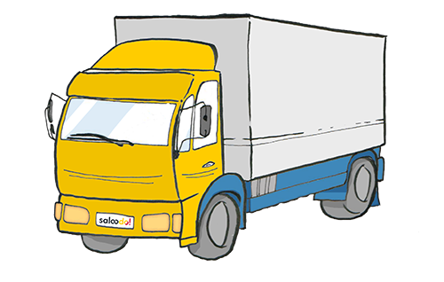
Problem Review
Background: Employer's need to ensure their truckers are working efficiently
Smartphone ubiquity offers a solution
Proposed High level system architecture
Detailed system design

Slide 3
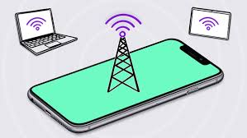
Problem Statement
Realize an audit trail system for monitoring truckers to ensure proper conduct.
Smartphone-powered tracking system for live logging of GPS coordinates, altitude, speed, acceleration.
Online interface for transmitting logged data.
Web Application for displaying trucker useful processed information.

Slide 4
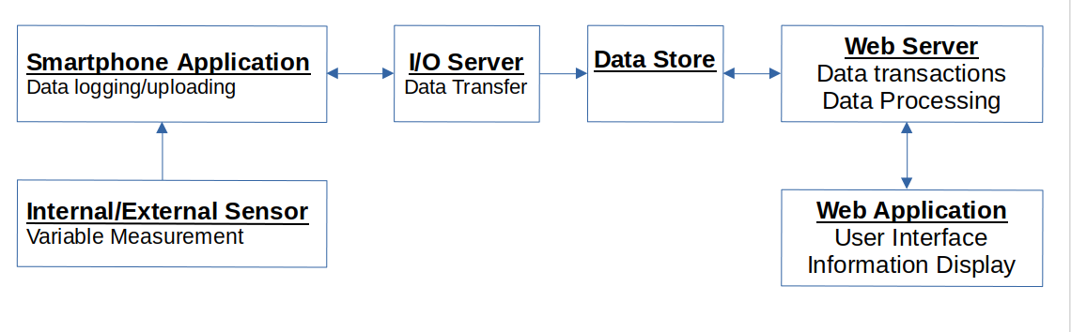
High level architecture
Smartphone Application
I/O Server
Data Store
Web Server
Web application

Slide 5
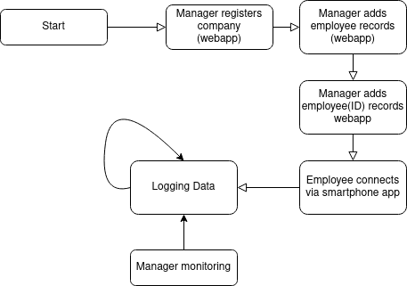
General system life-cycle

Slide 6
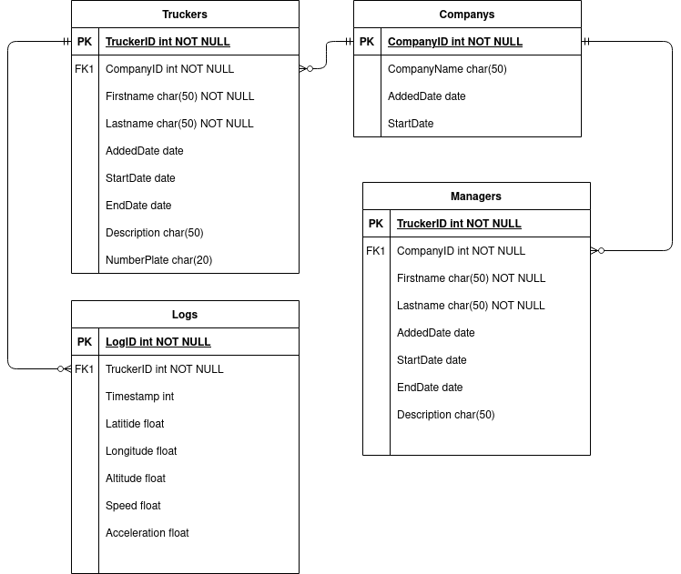
Data Model – Entity Relationship Diagram
Mariadb(MySQL) used because it is powerful and efficient.
ERD considers companies who employ truckers and managers(who monitor trucker logs)
A trucker has many log records stored
Logs consist of numeric types for database efficiency

Slide 7
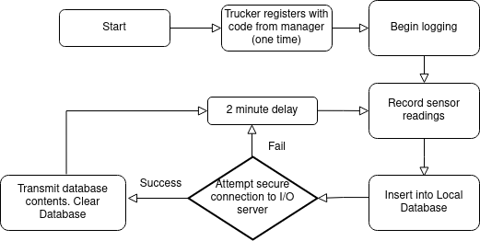
Smartphone Application – life cycle

Slide 8
Smartphone Application – general
High power consumption for accuracy
Android v4.2+ gives 95% android market, while having enough features
Google API exposes location system
Local lightweight database = cache
Secure connection with Secure Socket Layer (SSL/TLS) protocol for sensitive data

Slide 9
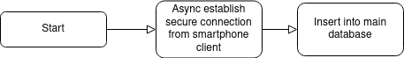
I/O Server
SSL/TLS for secure encrypted connection to smartpone app
Asynchronous functions for simultaneous connections
Insert log data into main database

Slide 10
Web Server
Kestrel web server well-integrated with ASP.NET Core for ease of development
Serves webapp

Slide 11
Web Application
Interface for managers, will allow:
Logging in
Add managers/employees to company
Add/List/view employee details
View logged gps data as arrow points on a map, indicating direction
Model-view-controller design pattern

